Slide 1

Welcome to your Level 4 Applied Teaching Practices
Quick starter thinking questions based on the 3 themes of this course:
Theme 1
Think back to when you started in your school.
What sort of teacher have you become?
Are you the ‘persona’, ’character’, ‘teacher’ that you envisaged you would be?
From your experience so far give 3 examples (1 for each) of what you consider to be vital for teachers to be effective in their role; ‘Professional Qualities, Characteristics and Relationships.’
Theme 2
Think back to the lessons you have delivered and any observations of your colleagues that you have completed.
What makes a good lesson?
What makes a good inclusive lesson and inclusive learning environment?
Theme 3
Think about how your school supports your pupils.
Give 2 examples of how your school supports the development of your pupils?
What do you think is meant by the terms ‘Holistic Education’ and the ‘Whole-Child Approach’?
Something to think about as you move through this course: Why should teaching be classed as a ‘profession’ and you as an educational professional? We will come back to this question during Training Day 2

Slide 2
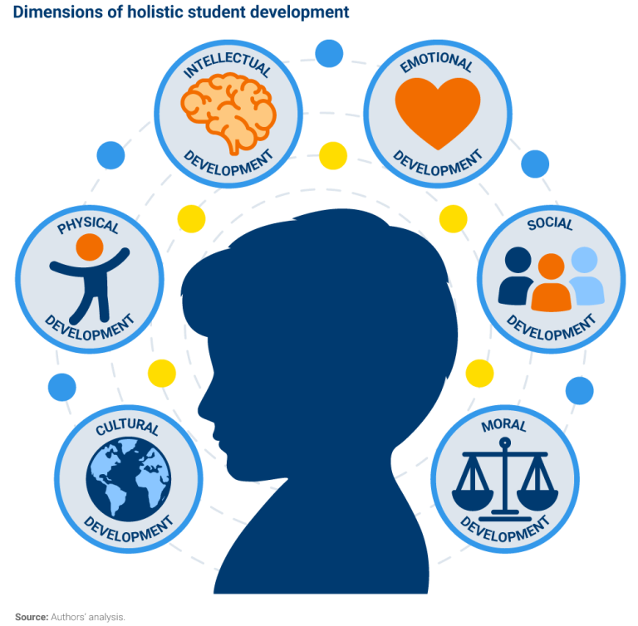
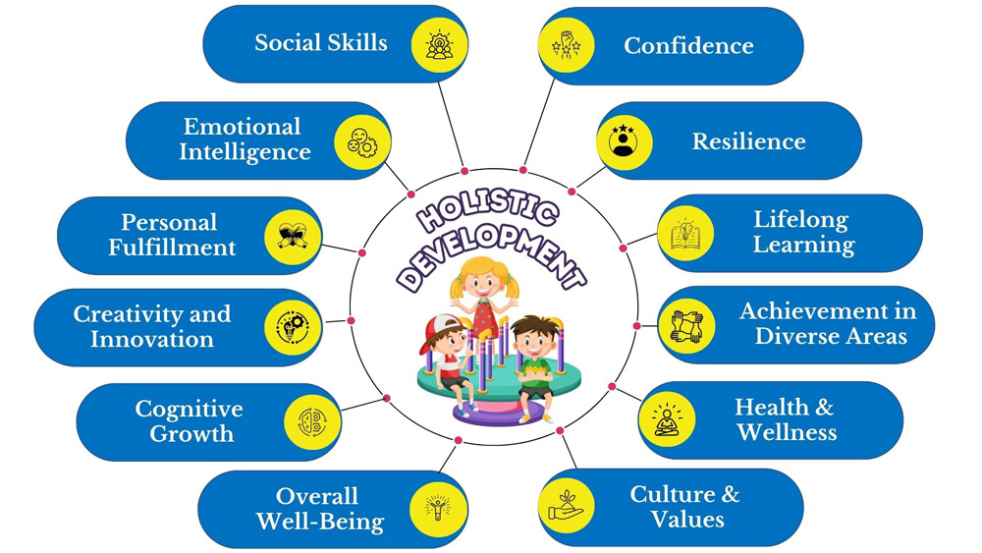
Holistic philosophy of Education

Slide 3
Agenda for this session
The rationale and structure of the L4 Applied Teaching Practices Course
Theme 1 (AO1):The importance of professional relationships, including trust, mutual respect, and clear communication, particularly when working with your Professional Assessor (PA) – one of the key focuses of this session
Theme 1 (AO1):The difference between mentoring and coaching in educational settings, and how each can support your development in different ways
Theme 2 (AO2): the 4 applied teaching skills you will focus on
Theme 3 (AO3): An introduction into the ‘Whole-Child’ approach, examining how school’s support pupils’ academic, social, and personal development
Theme 3 (AO3): An introduction to your ‘Wider School Community Project’ and the specific areas you can chose to focus on this term
AOB and any questions

Slide 4
The rationale of the course you will studying:
Give you the skills and the ability to manage workload, build resilience, cultivate effective working relationships with experienced colleagues and develop strong professional habits (Theme 1 AO1 & Theme 2 AO2).
Give you the core teaching competencies required to create inclusive, safe, and purposeful learning environments (Theme 2 AO2)
Ensure that you recognise the ethical, pastoral and safeguarding responsibilities of the profession and how to meet them (Theme 1 AO1 & Theme 3 AO3).
Provide you with an accredited qualification that reflects current educational sector priorities, including wellbeing, inclusion, whole-child development, and statutory RSE requirements (Theme 3 AO3).
Agenda item 1:The rationale and structure of the L4 Applied Teaching Practices Course

Slide 5
The structure and support available for the L4 Applied Course:
You will be working on the AO’s SIMULTANEOUSLY every week
To support you to be able to do this you will be given a Student Guide to weeks including links to the AO’s
On a Monday you will be emailed a ‘Monday Mailer’ to inform you of what you are required to complete that week.
If you have any further questions after referring to these 2 documents and the Trainee Hub please email: TeachingandLearning@Grad2Teach.ac.uk
Remember when uploading documents, they need to be a PDF document and clearly labelled.
You will receive feedback from either the T&L team or your PA depending on the document that you have uploaded. Please respond to any action points or questions in full to enable you to meet that specific assessment criteria.
Agenda item 1:The rationale and structure of the L4 Applied Teaching Practices Course

Slide 6
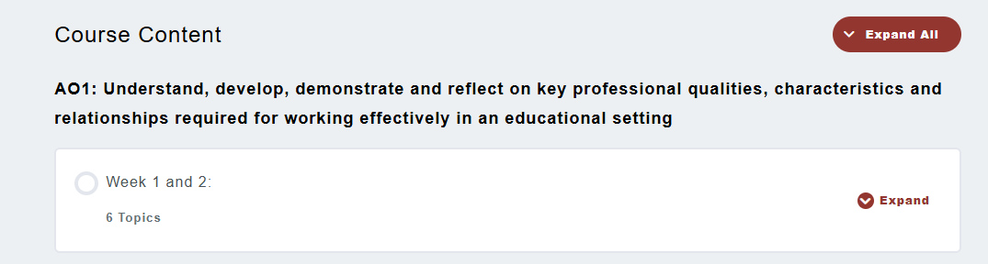
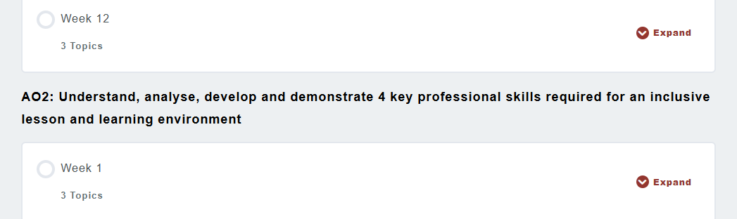
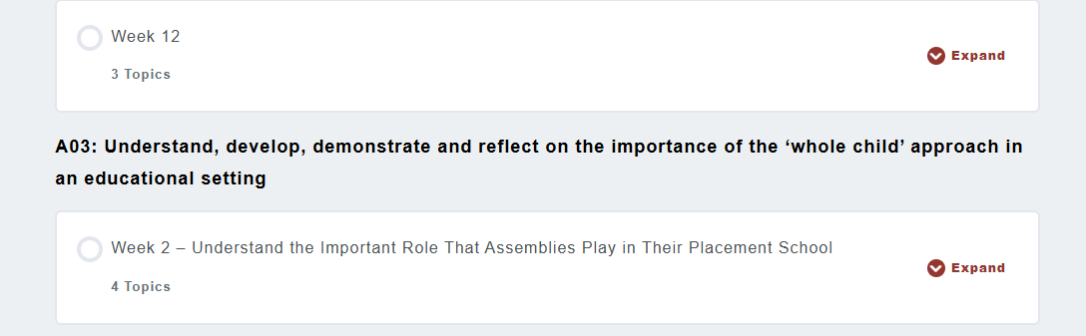
This is the view you will see of the 3 AO’s on the Trainee Hub.
You will need to scroll down to all 3 of the AO’s to check the specific tasks for the week you are for each AO.

Slide 7
Theme 1: AO1: Understand, develop, demonstrate and reflect on key professional qualities, characteristics and relationships required for working effectively in an educational setting
Discussion Points:
Why are the following so important for effective professional relationships? Trust, Mutual Respect and Clear Communication
Are they any other qualities and skills that help you to build effective professional relationship?
What is meant by taking ownership of your professional development and what do you think this will involve in this course?
We have covered aspects of this section earlier on. Why do you think that I have included ethics and morals as well
This theme is split into 3 sections:
Mentoring and building key professional relationships
Taking ownership of your professional development
Key characteristics, ethics and morals that make teaching a distinct profession
Agenda Item 2: Professional Relationship especially working with your Professional Assessor (PA)

Slide 8
Why do you think you have you been given a PA in the Application Term rather than last term?
How do you think you can make the most of having a PA until the end of Phase 1?
Discussion Points
AO1:1.5 Analyse the role of the Grad2Teach Professional Assessor (PA) in the trainee’s development as a teacher - your deadline will be in W5 after you have worked with your PA for the first month.
How will having a PA prepare you for your PGCE, or AOR portfolio?
Agenda Item 2: Professional Relationship especially working with your Professional Assessor (PA)

Slide 9
When you receive your PA feedback:
Actively and carefully read your feedback and you may need to refer back to your lesson plan or observing colleagues document for clarification.
Take time to think about your feedback and how you can apply it in future lessons/observations in school
Use the feedback to assess your progress as a teacher and identify your areas of strength and areas that you need to improve.
Take part in a meaningful self-examination and think critically about your own practice to enable you to move forward.
It is important to respond specifically and directly to the feedback (don’t be general). Always refer to your own practice and how you can adapt, amend and make use of the strategies you have seen in your observations (OC) or your evaluation of your lesson plans (LP) what could you do differently next time and why.
If you don’t understand an aspect of your PA’s feedback – ASK – if you have further questions – ASK. Remember your PA is there to support your development as a practitioner and take advantage of their expertise!
Think
The Power of Reflection when working with your PA
Task: When you receive your PA feedback what should you do?
Agenda Item 2: Professional Relationship especially working with your Professional Assessor (PA)

Slide 10
Look at the 2 examples of PA feedback and Trainee responses on the Trainee Hub on the next slide.
Task: Think about:
The appropriateness of the trainees’ response in terms of reflection quality
Is the trainee actively responding clearly to the PA’s feedback?
Is the trainee taking action following the feedback?
How could the trainees’ reflections be improved?
Agenda Item 2: Professional Relationship especially working with your Professional Assessor (PA)

Slide 11
Task: Think about:
The appropriateness of the trainees’ response in terms of reflection quality
Is the trainee actively responding clearly to the PA’s feedback?
Is the trainee taking action following the feedback?
How could the trainees’ reflections be improved?
Example 1: Lesson Plan
PA: ‘…If you were to go back to plan this lesson again – with all that you have learnt from this experience – what 2 things would you do differently?’
Trainee: ‘…If I had to plan this lesson again, I would speak to the SEN Team the day before the lesson to find out who would be supporting the SEN students and find out how they would like me to support them and the students. I will take the TA through what I will be covering in the lesson, so they can prepare and be ready in advance of the lesson… Secondly, after explaining the plenary, I would set the expectation for quiet working, and ask a student to distribute the worksheets. This minimises disruption and allows more time for me to teach the class, checking that they understand what the task is, while someone else distributes the work and there is a stronger transition to independent work…’
Example 2: Observing Colleagues
PA: ‘…Good to see a clear teacher standard (TS7) focus for this observation of your colleague and you have written down the range of strategies the teacher used. Good to see that you are going to use these strategies in your own lessons, especially with this class where you find behaviour management more challenging. Have used any of these strategies since the observation and have they had an impact with this class?
In your evaluation of this observation – why did these strategies work with this group (thinking about your own experience with this class)? Did the pupils make progress towards the LO (do try to write the LO out in full to enable you to make a judgement). What were the specific activities and why were they successful in enabling pupils to make good progress towards the LO? Were any of the activities planned for the lesson help to support pupil behaviour (support pupil engagement) as well as the behaviour strategies that you observed?
Trainee: ‘I have used these strategies in my classes after my observation and they have been a real success. I have found it particularly useful to be as consistent as the class teacher with these strategies as the pupils benefit with the consistency.’
Agenda Item 2: Professional Relationship especially working with your Professional Assessor (PA)

Slide 12
AO1:1.5 Analyse the role of the Grad2Teach Professional Assessor (PA) in the trainee’s development as a teacher - your deadline will be in W10 after you have worked with your PA for the majority of the course
Your PA portfolio of evidence will consist of 6 x Lesson Plans and 6x Observing Colleagues documents and 1x Lesson Observation Feedback document. Only your PA will feedback on these uploaded documents
Your PA will give feedback to the T&L team in W6 and W12 on how actively engaged you have been with their feedback, advice and guidance.

Slide 13
Weeks 1 and 2 for AO1
AO1: Assessment Criteria 1.1 Compare the differences between mentoring and coaching in an educational setting
AO1: 1.2 Prioritise and justify their choice of the key behaviours and actions that a trainee’s mentor needs to instill in the first half term to enable the trainee to make a confident and competent start to their school placement
Mentoring
Similarities
Coaching
Agenda Item 3: The difference between mentoring and coaching in educational settings, and how each can support your development in different ways

Slide 14
Weeks 1 and 2 for AO1
AO1: Assessment Criteria 1.1 Compare the differences between mentoring and coaching in an educational setting
AO1: 1.2 Prioritise and justify their choice of the key behaviours and actions that a trainee’s mentor needs to instill in the first half term to enable the trainee to make a confident and competent start to their school placement
Mentoring
Similarities
Coaching
Where a more inexperienced colleague will work with a more experienced colleague
The more experienced colleague will share their expertise, offer advice and guidance enabling their more inexperienced colleague to develop professionally
Longer term support
Both are development approaches, usually 1 to 1 to improve your knowledge and skills. They are distinctive but very complementary approaches to support the development of colleagues
A structured process that focuses on a specific skill or knowledge that you want to develop/improve
Non-directive unlike mentoring
Tends to be short-term
Agenda Item 3: The difference between mentoring and coaching in educational settings, and how each can support your development in different ways

Slide 15
Theme 2 AO2: Understand, analyse, develop and demonstrate 4 key professional skills required for an inclusive lesson and learning environment.
Professional skill 1 is aimed at extending your understanding of how to create an inclusive learning environment and building strong relationships (TS1) W1 to 3.
Professional skill 2 is aimed at expanding your understanding of how to support your pupils with a range of additional needs (TS5) W4 to 6.
Professional skill 3 is aimed at broadening your understanding of lesson planning (TS4) Training Day 2 Thursday 28th May Welwyn Garden City W7 Half Term
Professional skill 4 is aimed at strengthening your understanding of the importance of having a secure subject knowledge when planning and delivering lessons (TS3) W8 to 10
AO2 Essay ‘What does a good lesson look like and how do you ensure that your learning environment and lessons are inclusive to all ability levels and learner types? Word count 1500 words with a 10% margin. Deadline W10
Agenda Item 4: The 4 applied teaching skills you will focus on

Slide 16

Agenda Item 5: An introduction into the ‘Whole-Child’ approach, examining how school’s support pupils’ academic, social, and personal development
Why should school’s adopt this approach?
‘Promote Long-Term Development and Success
ASCD's Whole Child approach transitions from a focus on narrowly defined academic achievement to one that promotes the long-term development and success of all children.’
https://www.ascd.org/whole-child

Slide 17
Theme 3 AO3: Wider School Community Project
Your project in this course will be based on what your school offers your pupils in terms of their whole-child provision.
For AO3 your first 4 weeks will be to investigate different aspects of your school’s provision and decide which area you would like to be involved in.
W2: Attend an assembly
W3: Attend an extra-curricular class or session of your choice
W4: Meet with key pastoral colleagues and observe a pastoral session e.g. Tutor Group
W4: Decide on your Wider School Community Project (WSCP)
You will be observing a PSHE/RSE session in W8 after half term – you may want to do this earlier if you are interested in being involved with PSHE for your WSCP.
The deadline for your WSCP as the deadline is in W12.
Agenda Item 6: An introduction to your ‘Wider School Community Project’ and the specific areas you can chose to focus on this term

Slide 18
Key date: Face-to-Face Training (Training Day 2) in Half Term on Thursday 28th May at Orion House, 15 Bessemer Rd, Welwyn Garden City AL7 1HU. Where the new Grad2Teach office is. More information to follow from Simona
Any questions?
Thank you for your contributions today and have a good evening and rest of your week.

